Slide 1
STEM at P.R.
It’s happening!

Slide 2
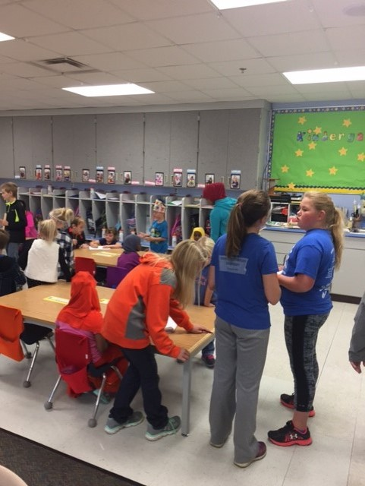
Measuring kindergarteners

Slide 3
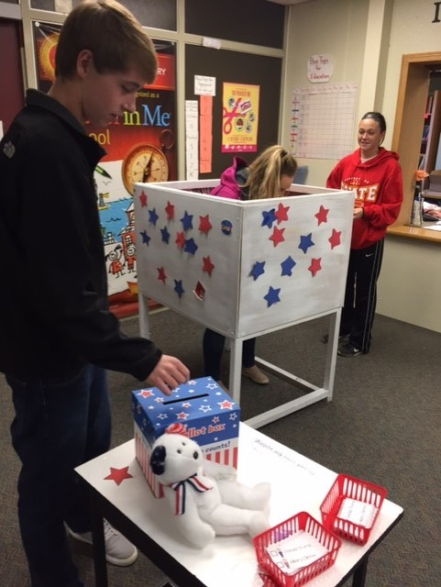
Election voting booth

Slide 4
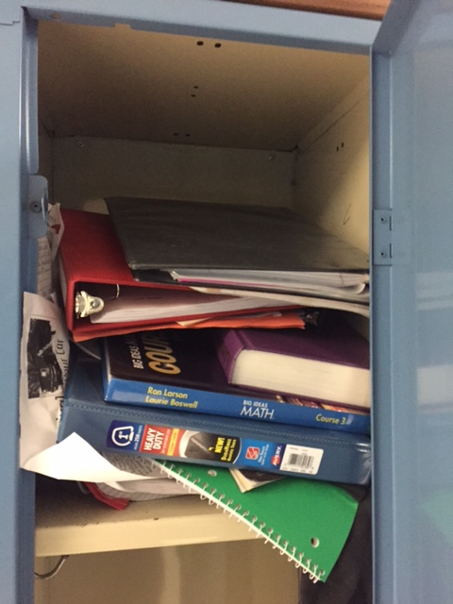
Problem

Slide 5
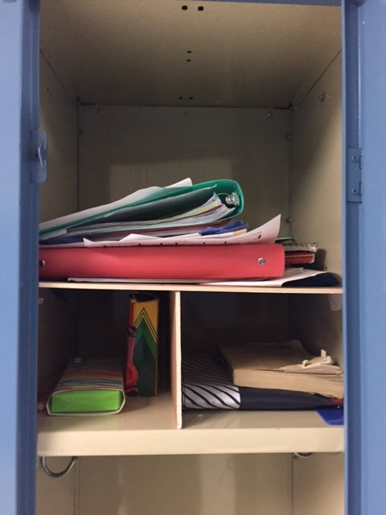
Locker organizers

Slide 6
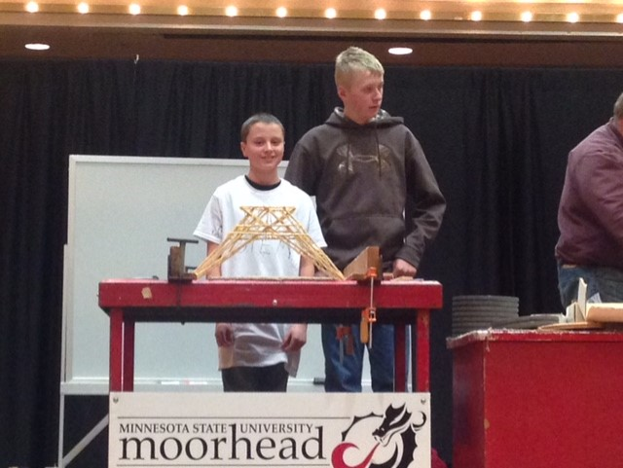
Toothpick bridge competition

Slide 7
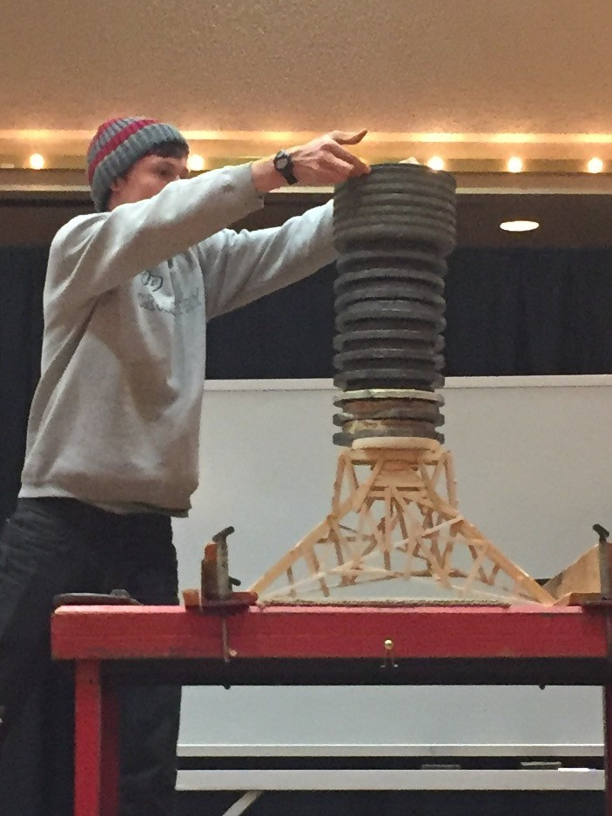
Goals

